Slide 1
Servers for aperiodic tasks
Principles for server design
Explaining servers through example
1

Slide 2


Slide 3
Aperiodic tasks
How do we deal with aperiodic tasks?
Why?
Critical, but occasional, operations that require immediate attention
Occasional events that need to completed soon, but periodic tasks are more important and need to meet their deadlines; aperiodic tasks do not have hard deadlines
Examples: system mode changes, activity logs, garbage collection
3

Slide 4
Mixing periodic and aperiodic tasks
Question: how to execute aperiodic tasks without violating schedulability guarantees given to periodic tasks?
And in a static-priority environment
4

Slide 5
Mixing periodic and aperiodic tasks
Question: how to execute aperiodic tasks without violating schedulability guarantees given to periodic tasks?
And in a static-priority environment
Easy approach: schedule aperiodic tasks at the lowest priority level
In the “background”
Problem: Extremely poor performance for aperiodic tasks; periodic tasks can be delayed as long as they do not miss their deadlines
5

Slide 6
Server-based systems
Periodically invoke a service task (“server”) to execute aperiodic tasks
The server is modeled as a periodic task and can be included in schedulability analysis
Allocate the server a computation budget Cs and a period P_{s}
The server can serve aperiodic tasks until the budget expires; the budget can be replenished every period
Many choices: Servers have different flavors depending on the details of when they are invoked, what priority they have, and when budgets are replenished
Budget, C_{s}
Server
Period, P_{s}
6

Slide 7
Server-based systems
Periodically invoke a service task (“server”) to execute aperiodic tasks
The server is modeled as a periodic task and can be included in schedulability analysis
Allocate the server a computation budget Cs and a period Ps
The server can serve aperiodic tasks until the budget expires; the budget can be replenished every period
Many choices: Servers have different flavors depending on the details of when they are invoked, what priority they have, and when budgets are replenished
Server
Aperiodic Tasks
7

Slide 8
Server-based systems
Periodically invoke a service task (“server”) to execute aperiodic tasks
The server is modeled as a periodic task and can be included in schedulability analysis
Allocate the server a computation budget Cs and a period Ps
The server can serve aperiodic tasks until the budget expires; the budget can be replenished every period
Many choices: Servers have different flavors depending on the details of when they are invoked, what priority they have, and when budgets are replenished
Server
Aperiodic Tasks
8

Slide 9
Polling Server
Runs as a periodic task (priority set according to policy)
Aperiodic arrivals are queued until the server task is invoked
(Any) server is said to be active if its budget is > 0 and is either:
Running: it is the highest priority task and is servicing an aperiodic request, or
In ready queue: has been preempted by a higher priority task while servicing an aperiodic request or arrived while a higher priority task is running
otherwise it is idle (in the waiting queue)
When the server is invoked it serves the aperiodic queue until it is empty or until the budget expires then suspends itself
Suspends itself: removed from ready queue and placed in waiting queue → becomes idle
If server is idle, then it is returned to ready queue in the event of its next arrival (period, which is the next replenishment time) and then a scheduling decision is made
Server is treated as a regular periodic task in schedulability analysis
9
Notes:
If server arrives but is not the highest priority task, it does not suspend itself if the aperiodic queue is empty (waits until it is invoked)

Slide 10
Example of a Polling Server
Polling server:
Period P_{s} = 5
Budget C_{s} = 2
Periodic task
P = 4
C = 1.5
All aperiodic arrivals have C=1
Aperiodic arrivals
10

Slide 11
Example of a Polling Server
Polling server:
Period P_{s} = 5
Budget C_{s} = 2
Periodic task
P = 4
C = 1.5
All aperiodic arrivals have C=1
Aperiodic arrivals
11

Slide 12
Example of a Polling Server
Polling server:
Period P_{s} = 5
Budget C_{s} = 2
Periodic task
P = 4
C = 1.5
All aperiodic arrivals have C=1
Budget
Aperiodic arrivals
12

Slide 13
Polling server
Server is just another periodic task → Under RM: periodic task feasible if
With more careful analysis and assuming $T_{s}$ is the highest priority task
Replicate LL bound analysis for RM
13

Slide 14
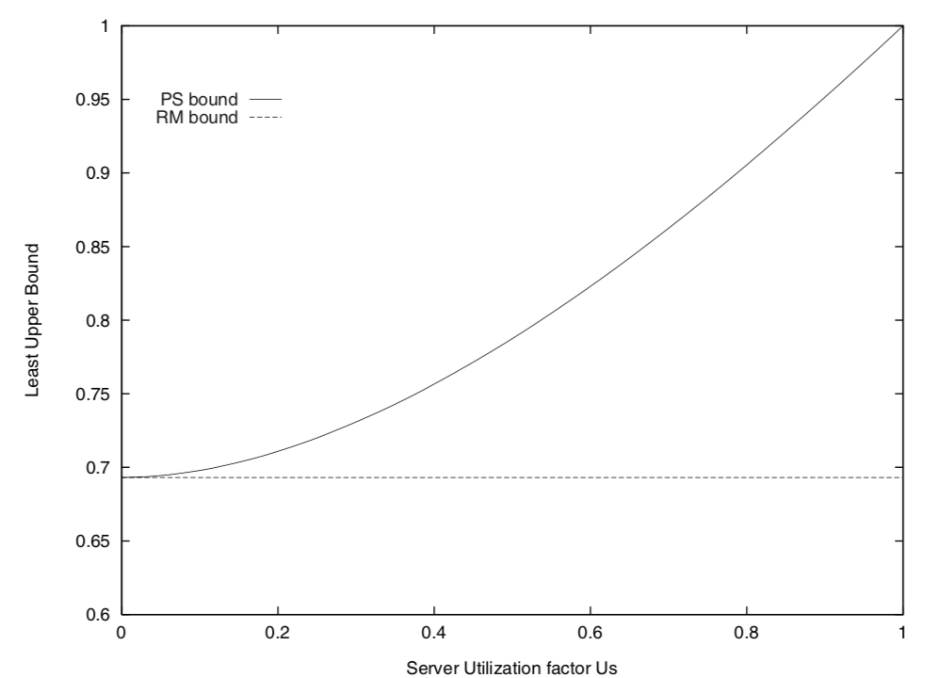
Polling server
vs.
14

Slide 15
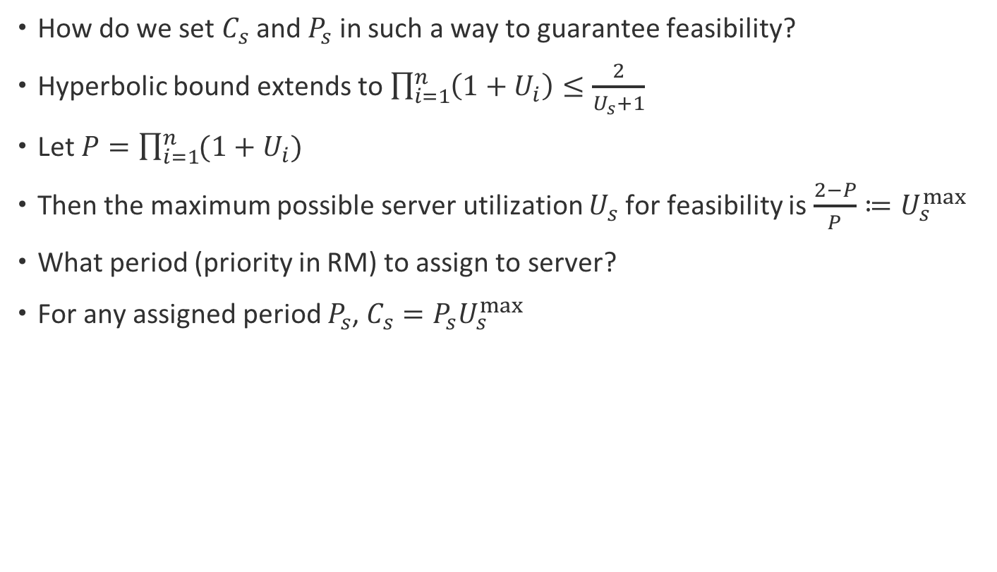
How to dimension a polling server?
How do we set $C_{s}$ and $P_{s}$ in such a way to guarantee feasibility?
Hyperbolic bound extends to $\prod_{i=1}^{n}{\left(1+U_{i}\right)≤\frac{2}{U_{s}+1}}$
Let $P=\prod_{i=1}^{n}{(1+U_{i})}$
Then the maximum possible server utilization $U_{s}$ for feasibility is $\frac{2−P}{P}≔U_{s}^{max}$
What period (priority in RM) to assign to server?
For any assigned period $P_{s}$, $C_{s}=P_{s}U_{s}^{max}$
15
Notes:
how can we select the pair (Cs, Ps) that enhances aperiodic responsiveness? A simple solution is to assign the server the highest priority; that is, the smallest period, under Rate Monotonic. However, it is not useful to set Ts < T1, since a smaller Ts implies a smaller Cs, which would cause higher fragmentation (i.e., higher runtime overhead) in aperiodic execution.

Slide 16
Example of a Polling Server
Polling server:
Period P_{s} = 5
Budget C_{s} = 2
Periodic task
P = 4
C = 1.5
All aperiodic arrivals have C=1
Why not execute immediately?
Budget
Aperiodic arrivals
16

Slide 17
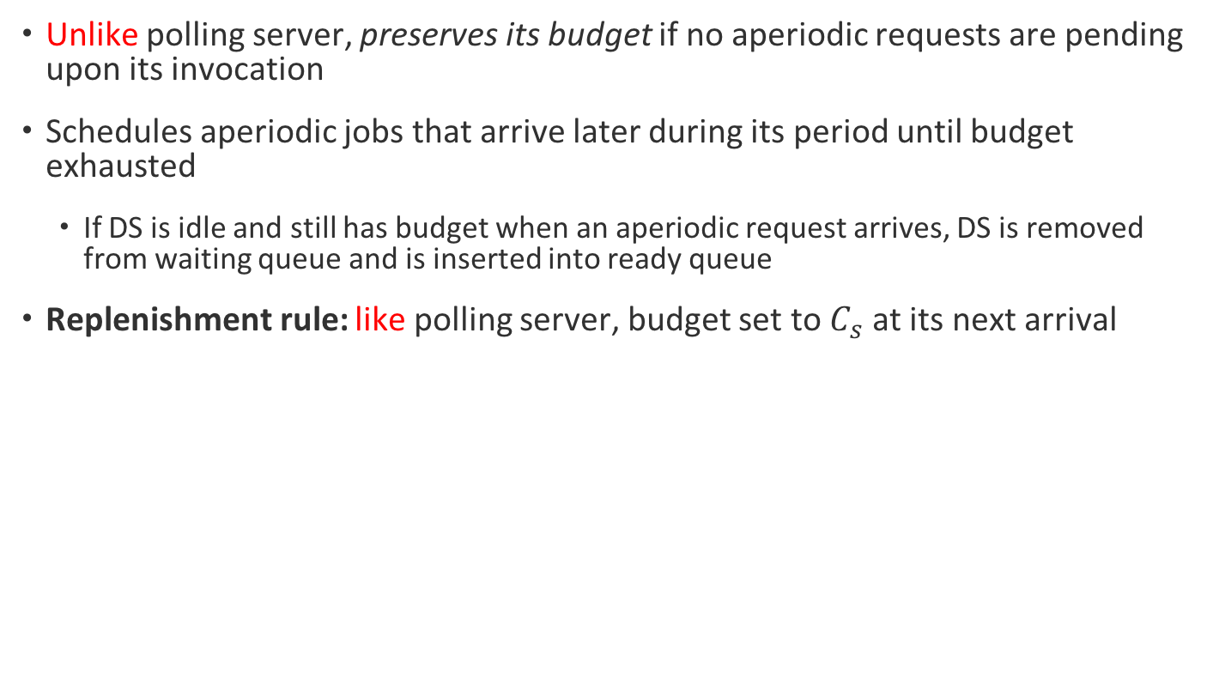
Deferrable server
Unlike polling server, preserves its budget if no aperiodic requests are pending upon its invocation
Schedules aperiodic jobs that arrive later during its period until budget exhausted
If DS is idle and still has budget when an aperiodic request arrives, DS is removed from waiting queue and is inserted into ready queue
Replenishment rule: like polling server, budget set to $C_{s}$ at its next arrival
DS cannot be treated as a periodic task in schedulability analysis.
Why?
17

Slide 18
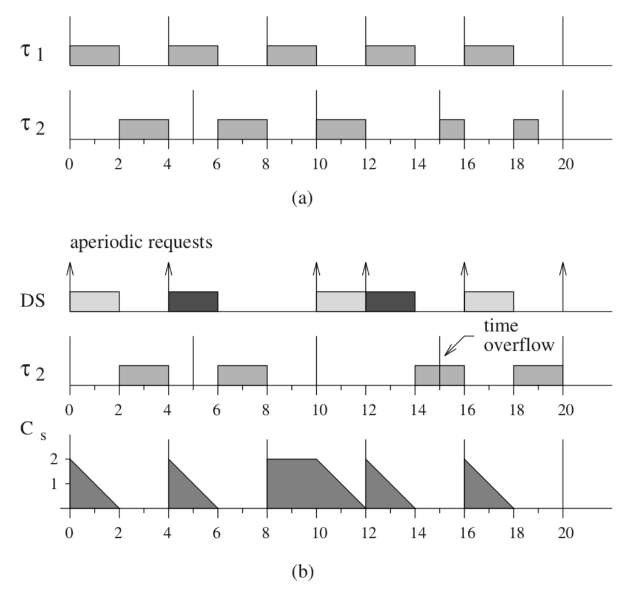
Deferrable server: Not a regular periodic task
18

Slide 19
Deferrable server: Not a regular periodic task
Back-to-Back hits
Invasive nature because it preserves capacity
Execution might be deferred till late in period → not how periodic tasks behave!
Not present in PS → if no period task available then PS suspends itself until next period
19

Slide 20
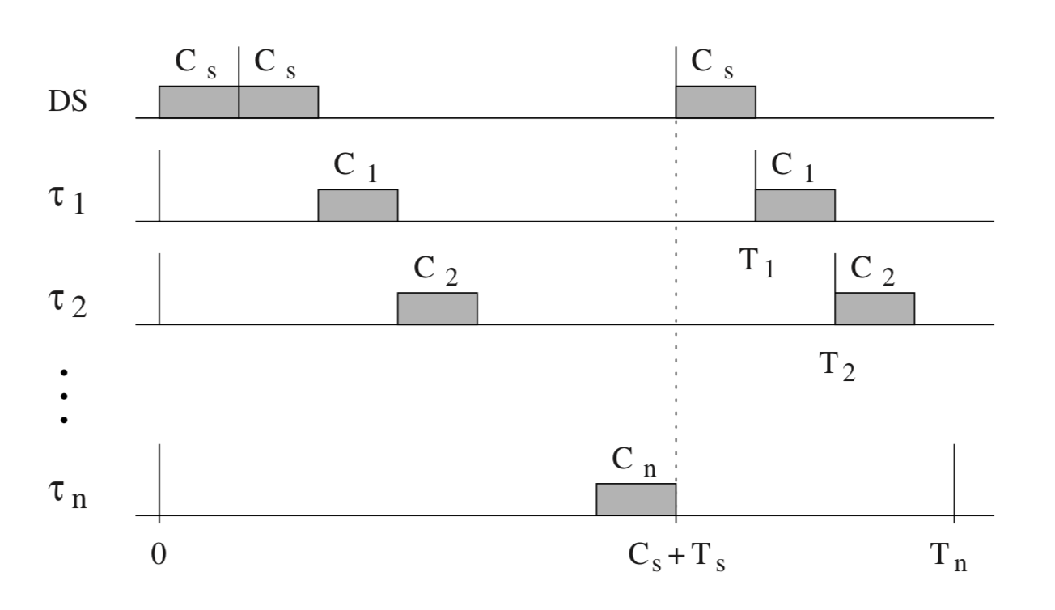
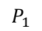
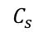
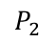
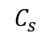
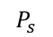
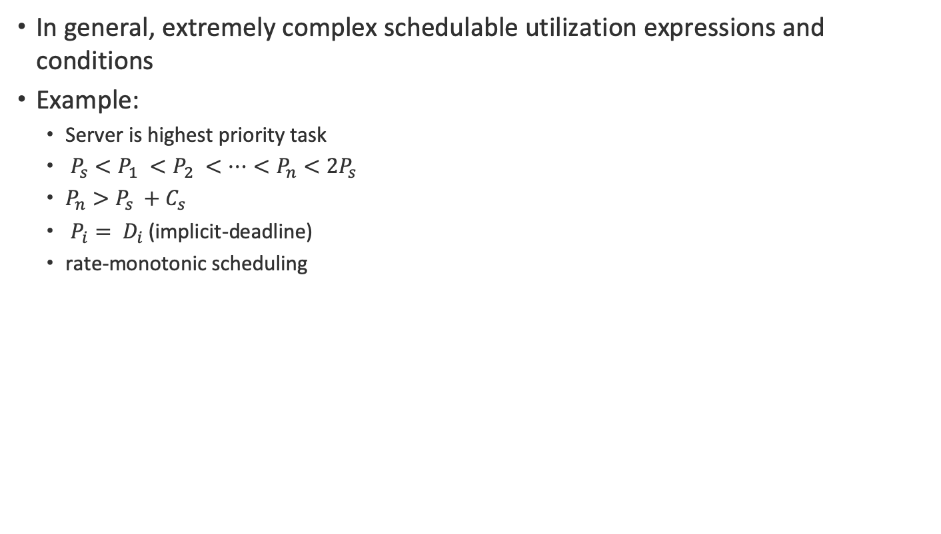
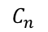
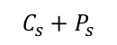
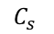
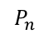
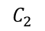
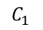

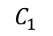
Deferrable server: Schedulable utilization
In general, extremely complex schedulable utilization expressions and conditions
Example:
Server is highest priority task
$P_{s}<P_{1} <P_{2} <…<P_{n}<2P_{s}$
$P_{n}>P_{s} +C_{s}$
$P_{i}= D_{i}$ (implicit-deadline)
rate-monotonic scheduling
$$C_{s}$$
$$C_{s}$$
$$C_{s}$$
$$C_{1}$$
$$P_{s}$$
$$C_{1}$$
$$C_{2}$$
$$P_{1}$$
$$C_{2}$$
$$P_{2}$$
$$C_{n}$$
$$C_{s}+P_{s}$$
$$P_{n}$$
Worst case conditions for DS
20

Slide 21
Sporadic Server
Fixes the invasive nature of DS
More complex consumption and replenishment rules ensure that a sporadic server with period P_{s} and budget C_{s} never demands more processor time than a periodic task with the same parameters
Allows server to be treated as a periodic task in schedulability analysis!
21

Slide 22
Sporadic Server
Every time the server becomes active, say at t_{A}, it sets replenishment time one period into the future, t_{A} + P_{s} (but does not decide on replenishment amount).
When the server becomes idle, say at t_{I} , set replenishment amount to capacity consumed in [t_{A}, t_{I}]
If an aperiodic request arrives when budges is zero, server does not become active and aperiodic request will have to wait till the next replenishment epoch
22
Notes:
If an aperiodic task arrives when the server is idle only because there were no aperiodic requests (budget is not zero), the server becomes active: Will be put back in the ready queue
If server was idle because its budget became 0, then it is inserted into ready queue as soon as its budget is replenished (even if its next arrival time is past its next replenishment time)
If server was idle because there were no aperiodic requests when it became the highest priority task (ready to run, which implies it had non-zero budget), then server is put back into ready queue as soon as either an aperiodic request arrives or the server task itself arrives (at its period boundary) [same as deferrable server]
In both cases, a scheduling decision is made after putting Ts back into ready queue

Slide 23
Sporadic Server: Example
T1
Two periodic tasks
T1: (P1=5, C1=1)
T2: (P2=15, C2=5)
Sporadic Server
Ps=10, Cs=5
T2
2
2
Aperiodic tasks
t=4
t=7
t=8
Sporadic server active
t=10
t=14
t=18
+0
+2
+2
Sporadic server
budget
23

Slide 24
An optimal static-priority server does not exist!
What is an optimal server?
One Possible Definition: A server is optimal if it minimizes the response time of every aperiodic request while maintaining feasibility of the periodic tasks
Is this definition fruitful or too ambitious to be achievable?
Result (weaker than result in text): There exists a set of periodic tasks scheduled according to a given fixed-priority scheme and a sequence of aperiodic requests ordered according to a given aperiodic queueing discipline for which no valid algorithm exists that minimizes the response time of every soft aperiodic request.
24
Notes:
This definition of optimality (Strongly optimal) is too ambitious and cannot be achieved.
Proof is an adversary argument:

Slide 25
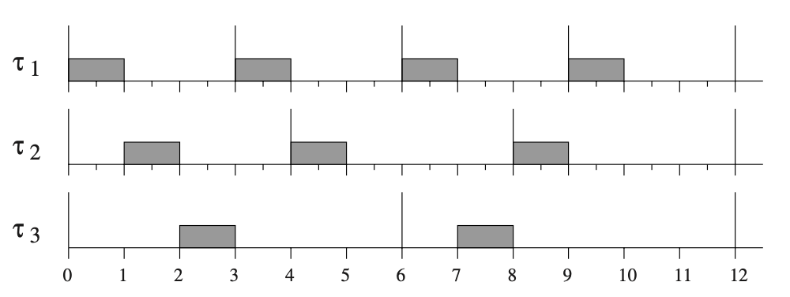
An optimal static-priority server does not exist!
25

Slide 26
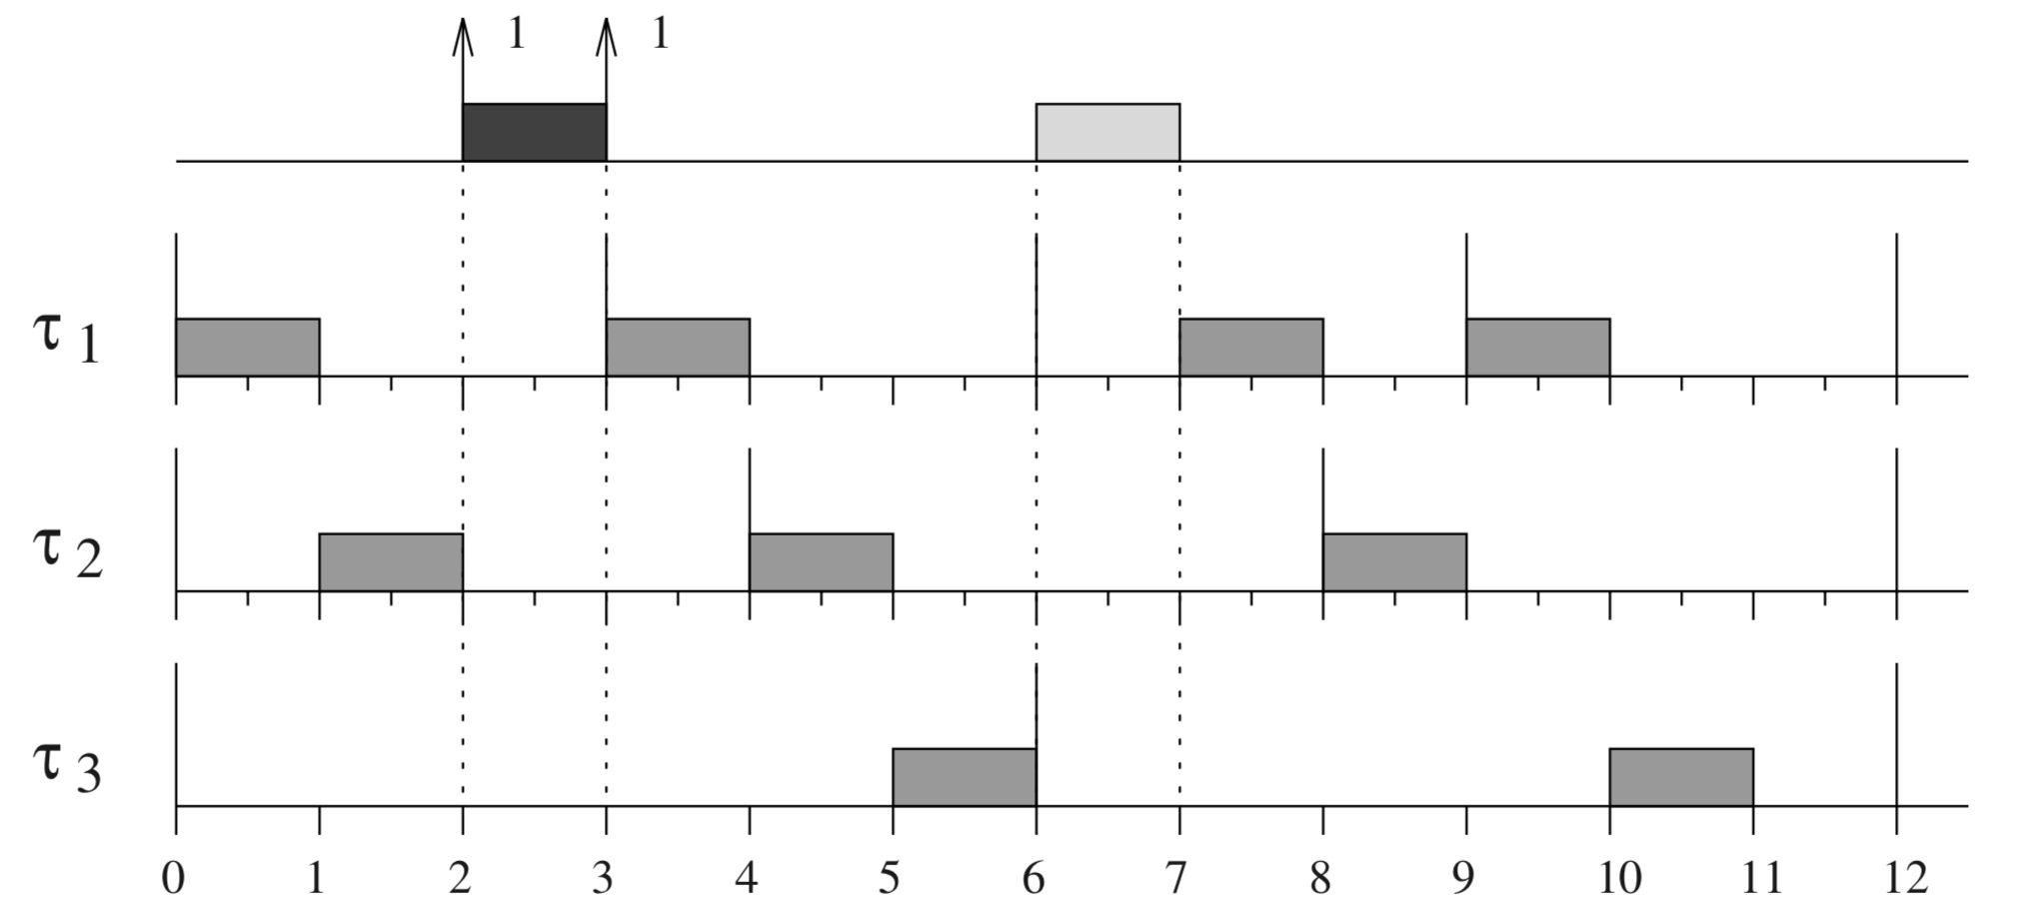
An optimal static-priority server does not exist!
26

Slide 27
An optimal static-priority server does not exist!
What is the minimum possible response time of J₁
without jeopardizing the schedulability of the periodic tasks?
Aperiodic requests
27

Slide 28
An optimal static-priority server does not exist!
Aperiodic requests
28

Slide 29
An optimal static-priority server does not exist!
This schedule minimizes the response time of first aperiodic request but not the second
Aperiodic requests
29

Slide 30
An optimal static-priority server does not exist!
This schedule minimizes the response time of second aperiodic request but not the first
Aperiodic requests
30

Slide 31
Dynamic priority aperiodic task servers
31

Slide 32
Dynamic sporadic server
In general, dynamic servers are based on assigning the server suitable time-varying deadlines so that the processor is fully utilized.
When the server is created its capacity C_{s} is initialized.
When server is idle and there is a pending aperiodic task and C_{s} > 0, server becomes “active”
Set a replenishment time one period into the future (deadline)
At time t_{A}, d_{s} := t_{A} + P_{s} becomes the absolute deadline of the server task
When the server becomes inactive set the replenishment amount as the capacity consumed
32

Slide 33
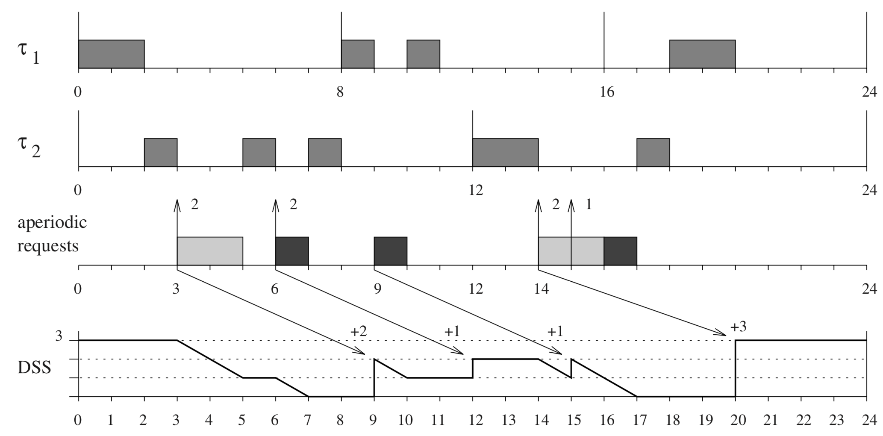
Example for dynamic sporadic server
Two periodic tasks
T1: (P1=8, C1=2)
T2: (P2=12, C2=3)
Dynamic sporadic server
PS=6
CS=3
Ties among tasks are always resolved
in favor of the server:
Increases responsiveness of aperiodic
requests without jeopardizing feasibility
of hard tasks
When the server is created its capacity C_{s} is initialized.
When there is a pending aperiodic task and C_{s} > 0, server becomes “active”
Set a replenishment time one period into the future (absolute deadline)
When the server becomes inactive set the replenishment amount as the capacity consumed
33

Slide 34
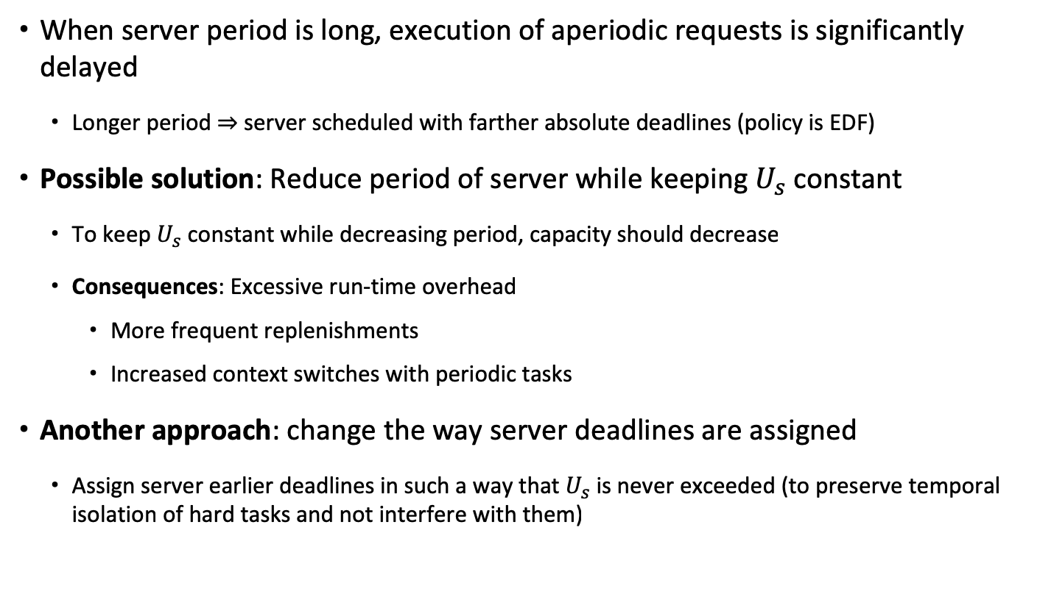
Dynamic sporadic server: Problems?
When server period is long, execution of aperiodic requests is significantly delayed
Longer period $⇒$ server scheduled with farther absolute deadlines (policy is EDF)
Possible solution: Reduce period of server while keeping $U_{s}$ constant
To keep $U_{s}$ constant while decreasing period, capacity should decrease
Consequences: Excessive run-time overhead
More frequent replenishments
Increased context switches with periodic tasks
Another approach: change the way server deadlines are assigned
Assign server earlier deadlines in such a way that $U_{s}$ is never exceeded (to preserve temporal isolation of hard tasks and not interfere with them)
34

Slide 35
The Constant Bandwidth Server (CBS)
Server has a maximum budget Q_{s} and a period P_{s}
The server is said to be active if jobs are pending, otherwise it is idle [much simpler definitions]
When an aperiodic job arrives it inherits the server deadline, d_{s}
When an aperiodic job executes the server budget is decreased by the same amount
When the budget is zero it is recharged to Q_{s} and deadline d_{s} is increased by P_{s}
new d_{s} = old d_{s} + P_{s}
Consequence: server remaining budget is never 0
When a job arrives at time t and the server is idle:
If remaining budget C_{s} > (d_{s} – t)U_{s} , the deadline is advanced to t + P_{s} [new d_{s} = t + P_{s}]
The main advantage of the CBS is that it can deal with overruns -- when jobs exceed their estimated computation times
35
Notes:
To achieve fairness and temporal isolation between tasks, during any interval [t, t+h] of length h, a task Ti should not execute for more than hUi under EDF (if all jobs execute for more than h Ui each, then the amount of work done in [t, t+h] is h \sum_i^n Ui > h, so a task will miss its deadline. So during [t, d_{s}], Ts should not execute for more than (d_{s} – t) U_{s} . If Cs > (d_{s} – t) U_{s}, then Ts might execute for more than (d_{s} – t) U_{s} in the interval [t, d_{s}] (if it remains the highest priority task during [t, d_{s}], might cause other tasks to potentially miss their deadlines.)
Postponing the deadline when the condition fails means that the priority of Ts is lowered to avoid interference on other tasks if aperiodic jobs overrun. This is not the case for TBS, because it depends on knowledge of the execution times Ck of the aperiodic requests, so unless the aperiodic requests respect the declared Ck, there is no guarantee that Ts will exceed its reservation Us.

Slide 36
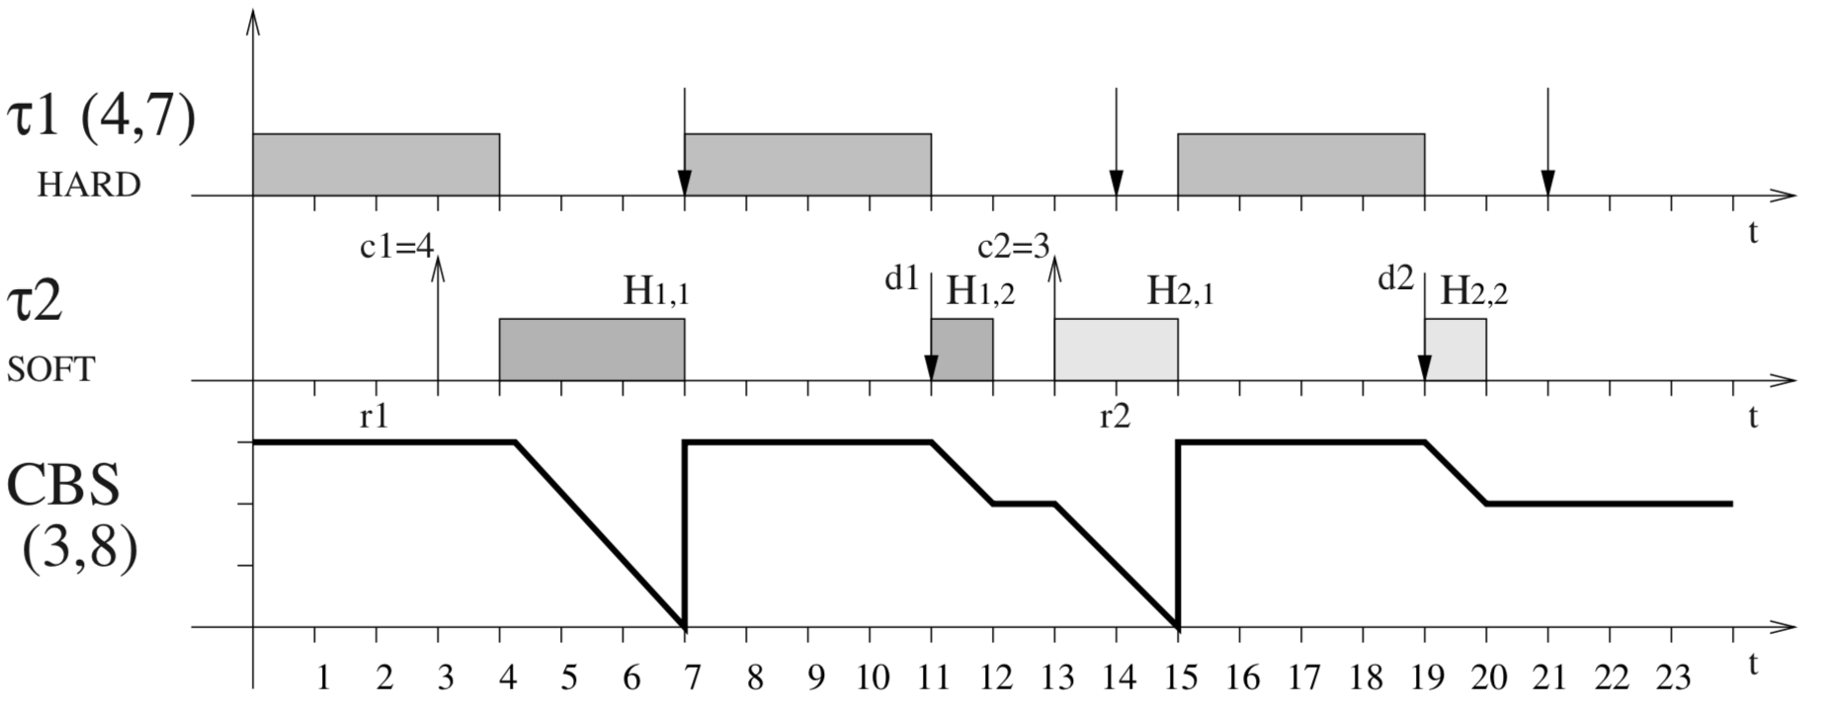
Example for CBS
Maximum budget
One hard periodic task
T1: (P1=7, C1=4)
One soft task served by a CBS
PS=8, QS=3
J2,1 has computation time 4 and arrives at t=3
J2,2 has computation time 3 and arrives at t=13
Current budget
The first instance of Task 2 (J2,1) arrives at t=3. At t=3, ds=8 and Cs=3. Cs = 3 > (ds-t)Us = 15/8. Therefore the server budget is recharged to 3 and the deadline is set to 3+8=11.
At t=7, the budget is exhausted so the new deadline is set to 11+8=19 and the budget replenished. At t=12, J2,1 is complete.
At t=13, J2,2 is released. Cs = 2 < (d_{s}-t)U_{s} = 9/4. J2,2 starts executing with deadline 19.
At t=15, the budget is exhausted. The new deadline of 19+8=27 is assigned to the server and the budget is reset to 3. J2,2 completes at t=20.
36

Slide 37
Principles of server design
It is simple enough to represent the servers as periodic tasks
So, why so many rules?
We want to reduce the response times for aperiodic tasks
Avoid the problems with the polling server: retain unused budget
If we want to retain the budget
When does it expire?
If a server has budget 2 and deadline 5, it cannot have a budget of 2 when t=4; there is only one unit of computation remaining but a budget of 2
We can not make the operating system do too much work. It only schedules by priority or deadline and does not verify if the deadline has expired or not.
37

Slide 38
Principles of server design
It is simple enough to represent the servers as periodic tasks
So, why so many rules?
We want to reduce the response times for aperiodic tasks
Avoid the problems with the polling server: retain unused budget
If we want to retain the budget
When does it expire?
When does it increase?
If we consume a portion of the budget, when do we restore it?
We cannot allow the server to use more than the allotted fraction of the processor: if the server has a utilization of 0.4, it can not use more than 2 units of time every 5 units (or 4 in every 10, 8 in every 20, ...)
How can we implement these easily? [The polling server is easy to implement.]
38

Slide 39
Summarizing aperiodic servers
Quite a few aperiodic server mechanisms
The difference between these schemes concerns performance and complexity (implementation, memory etc.)
CBS is used most often in the dynamic priority case: reasonable performance and easy implementation
Officially implemented in the Linux kernel since 3.14
39

Slide 40
Lecture summary
Aperiodic task servers
Static priorities
Polling Server
Sporadic Server
Dynamic priorities
Dynamic Sporadic Server
Constant Bandwidth Server
40

